Slide 1
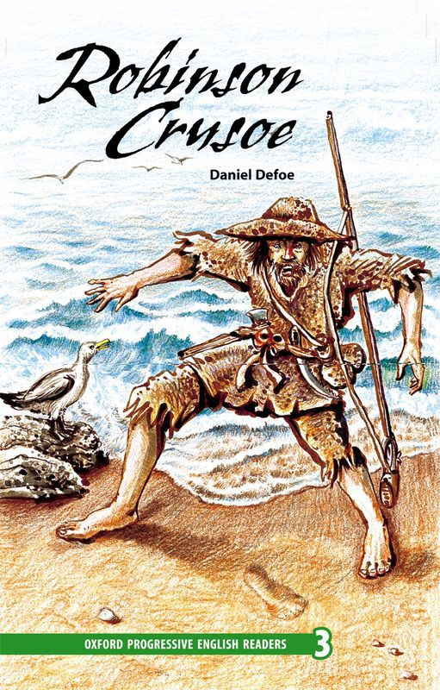

Slide 2
Book Review Robinson Crouse
Author: Daniel Defoe.
First Published: April 25, 1719.
Publisher: William Taylor.
Characters: Robinson Crusoe, Friday, the Captain, the Spaniard( inhabitant of Spain).
Genres: Novel, Historical Fiction, Adventure Fiction.

Slide 3
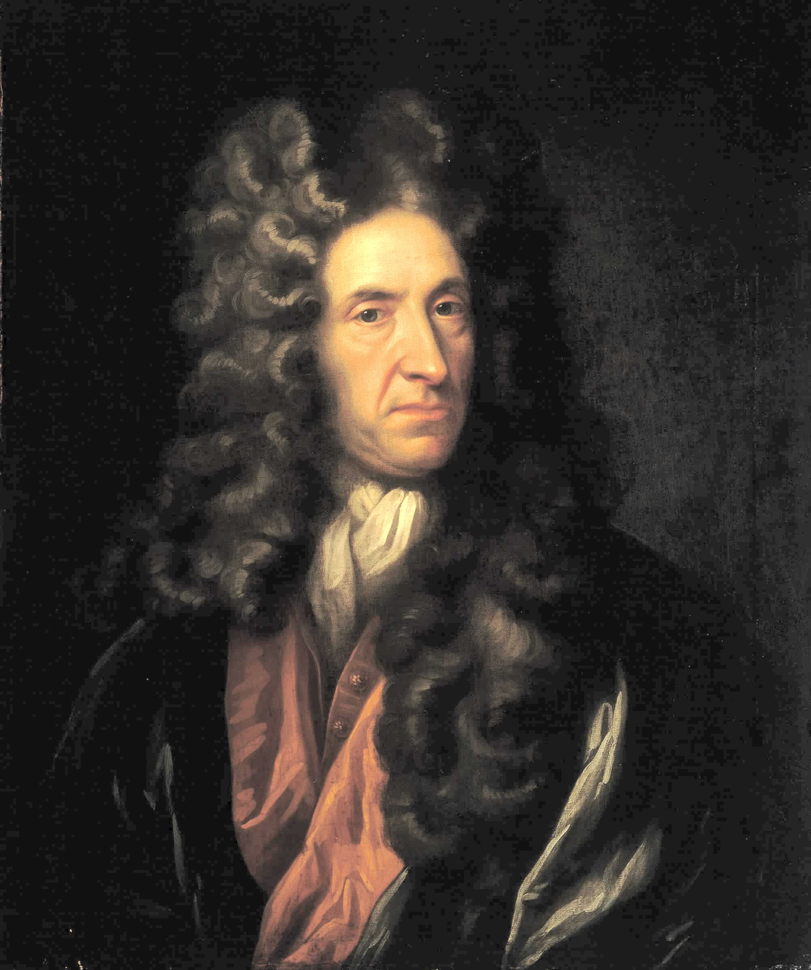
About Author
Date of Birth: In 1660.
Place of Birth: London, England.
Profession: Writer, Journalist, Novelist.
Information: Earliest English Novelist.
Daniel Defoe (1660 – 1731)

Slide 4
Summary

Slide 5
Thank You!

